Slide 1
CENG401 MACHINE LEARNING AND ARTIFICIAL INTELLIGENCE
WEEK-4
Informed (Heuristic) Search
Asst.Prof.Dr. Murat ŞİMŞEK

Slide 2

Informed (Heuristic) Search
Notes:
Intelligent agents are supposed to maximize their performance measure.

Slide 3
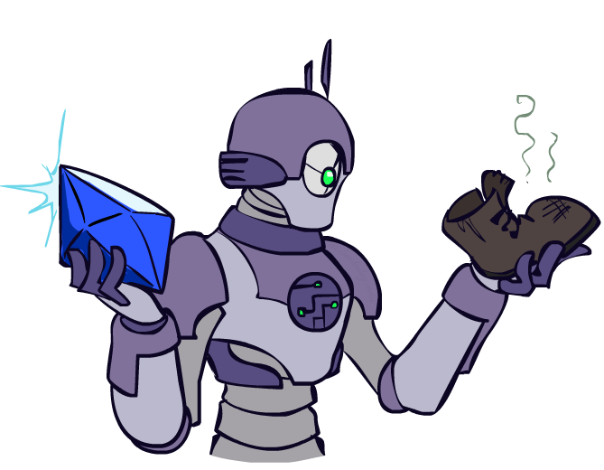
Today
Informed Search
Heuristics
Greedy Search
A* Search
Graph Search

Slide 4

Video of Demo Contours UCS Pacman Small Maze

Slide 5
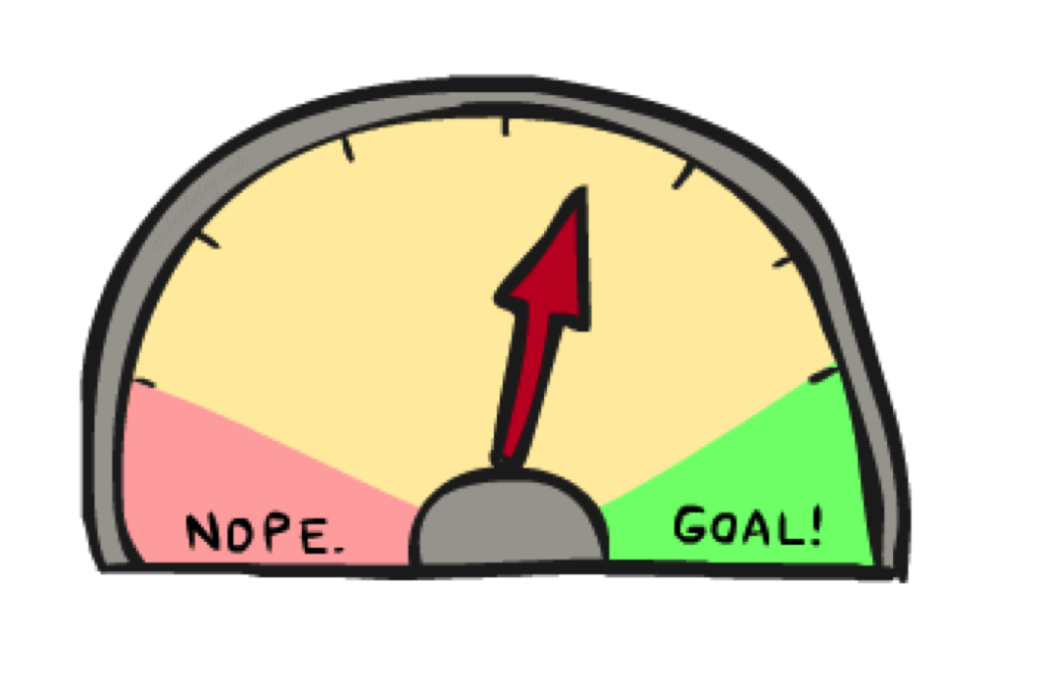
Informed Search
An informed search strategy uses knowledge beyond the definition of the problem
The knowledge is embodied in an evaluation function f(n)

Slide 6
Heuristic Search
Heuristic - a “rule of thumb” used to help guide search
something learned experientially and recalled when needed
Heuristic Search –
given a search space, a current state and a goal state
generate all successor states and evaluate each with our heuristic function
select the move that yields the best heuristic value

Slide 7



Search Heuristics
A heuristic is:
A function that estimates how close a state is to a goal
Designed for a particular search problem
Examples: Manhattan distance, Euclidean distance for pathing
10
5
11.2

Slide 8
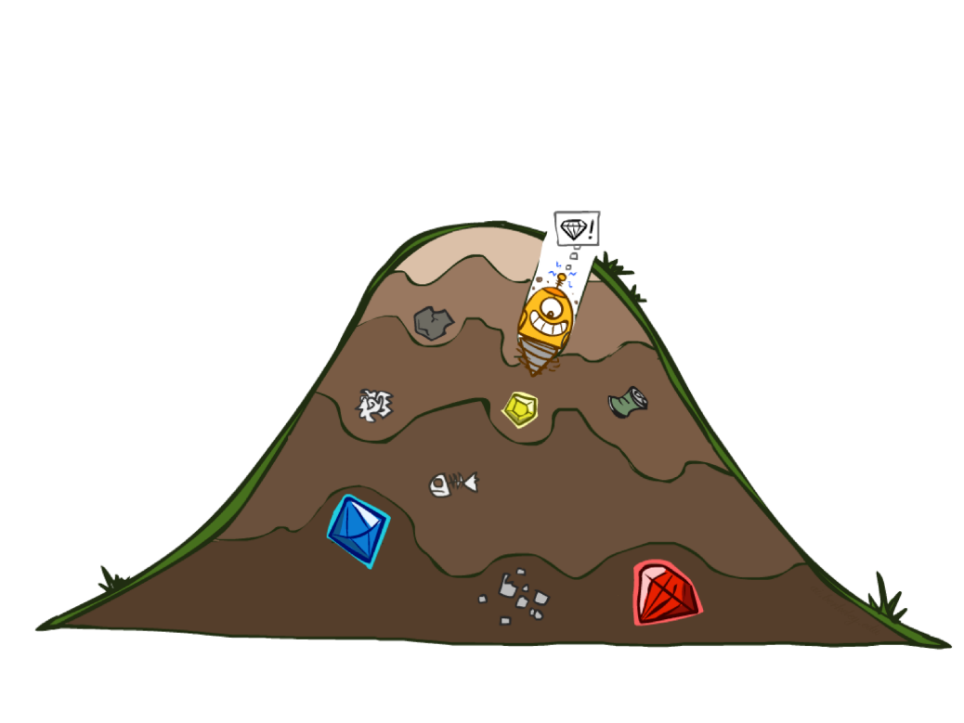
Greedy Search
Greedy search tries to expand the node that is closest to the goal, on the grounds GREEDY SEARCH that this is likely to lead to a solution quickly.
Expands node estimated to be closest to the goal
f(n) = h(n)

Slide 9
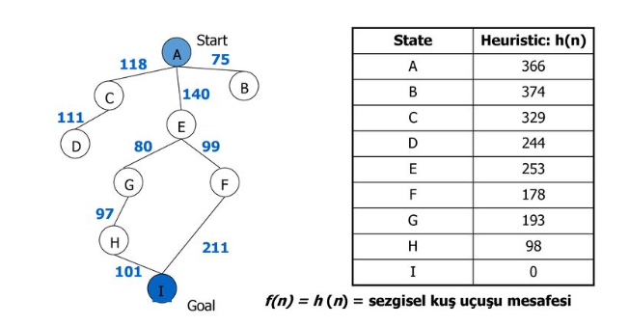
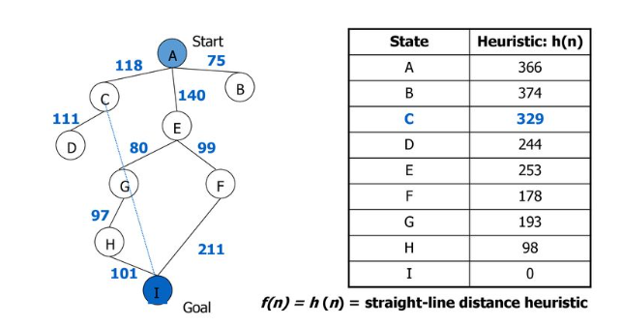
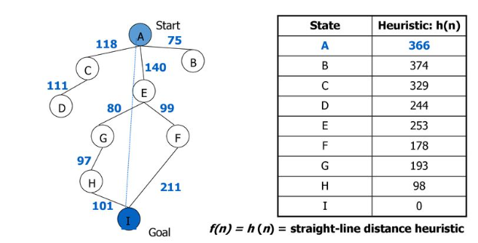
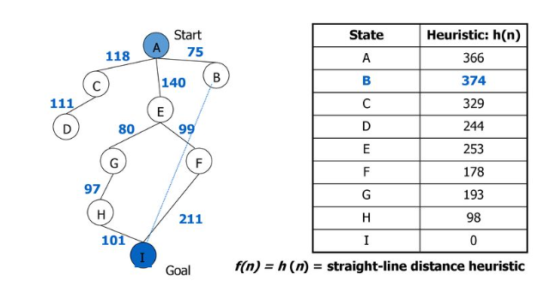
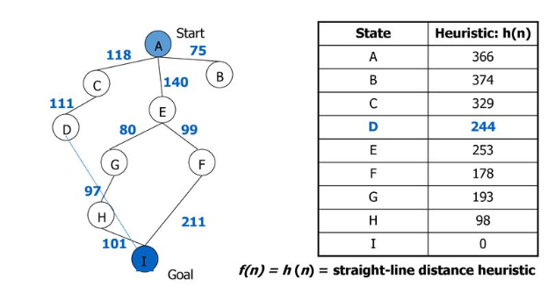
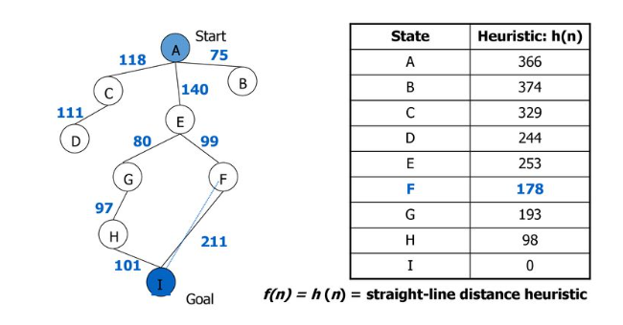
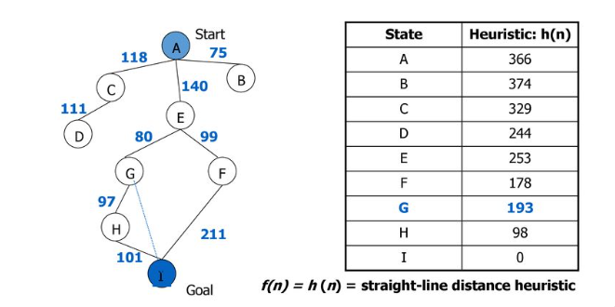
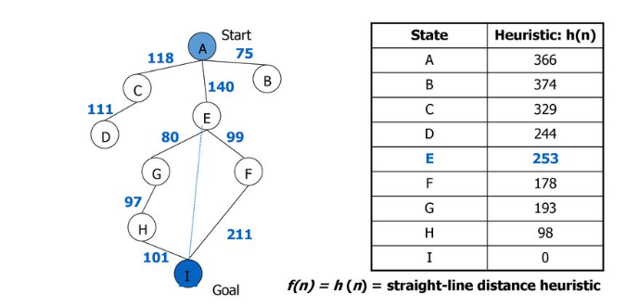
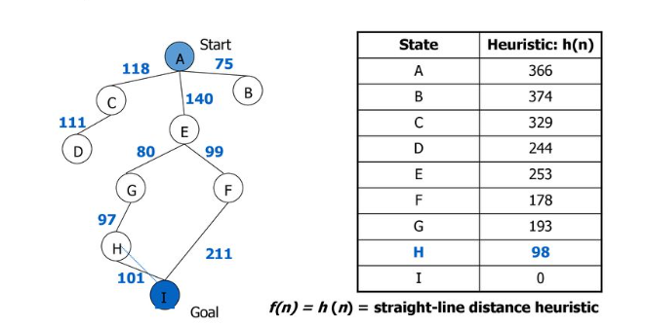
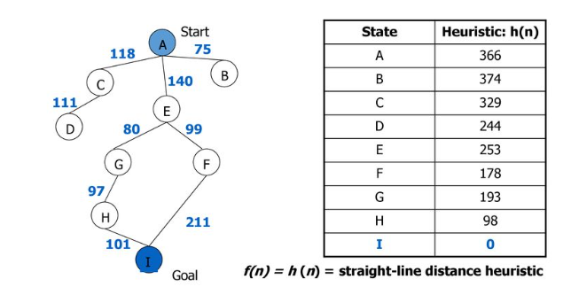
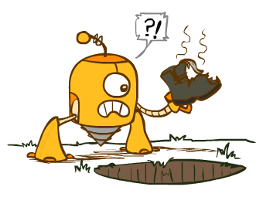
Greedy Search

Slide 10

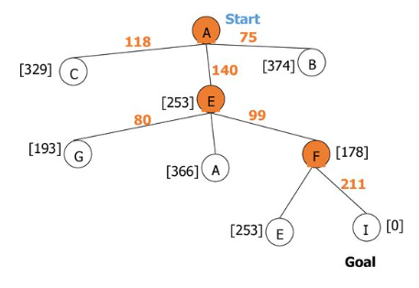
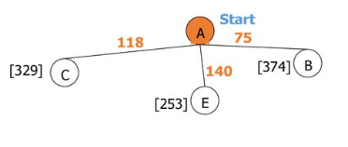
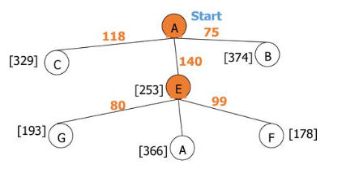
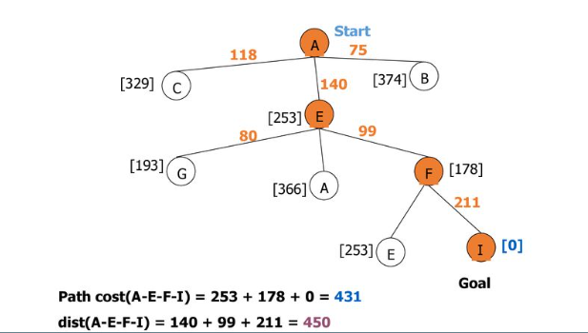
Greedy Search

Slide 11
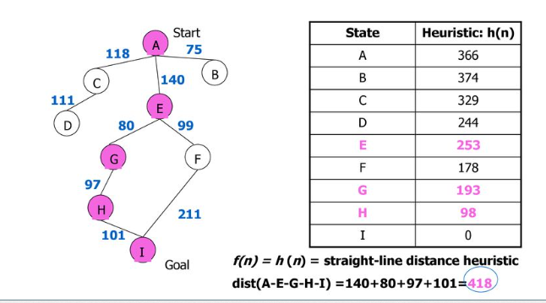
Greedy Search

Slide 12
Greedy Search
b
Strategy: expand a node that you think is closest to a goal state
Heuristic: estimate of distance to nearest goal for each state
A common case:
It takes you straight to the (wrong) goal
Worst-case: like a badly-guided DFS
…
b
…
Notes:
For any search problem, you know the goal. Now, you have an idea of how far away you are from the goal.

Slide 13
Video of Demo Contours Greedy (Empty)

Slide 14
Video of Demo Contours Greedy (Pacman Small Maze)

Slide 15
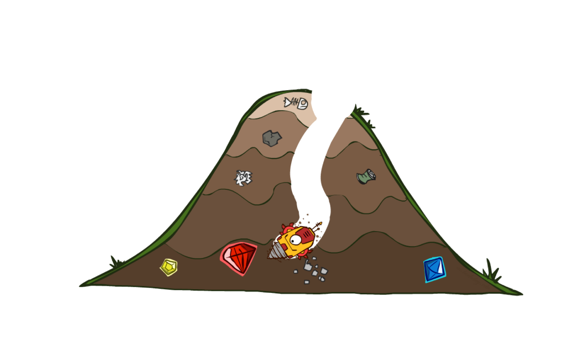
A* Search
The greedy search does not consider how costly it was to get to a node.
f(n) = h(n)
Idea: avoid expanding paths that are already expensive
Combine g(n), the cost to reach node n, with h(n)
f(n) = g(n) + h(n)
estimated cost of cheapest solution through n

Slide 16
Combining UCS and Greedy
Uniform-cost orders by path cost, or backward cost g(n)
Greedy orders by goal proximity, or forward cost h(n)
g(n) = cost of traversing from one node to another.
h(n) = heuristic approximation of the node's value.
A* Search orders by the sum: f(n) = g(n) + h(n)
8
g = 0 h=6
S
e
h=1
g = 1 h=5
a
1
1
3
2
g = 2 h=6
g = 9 h=1
S
a
d
G
b
d
g = 4 h=2
e
h=6
1
h=5
h=2
h=0
1
g = 3 h=7
g = 6 h=0
g = 10 h=2
c
b
c
G
d
h=7
h=6
g = 12 h=0
G

Slide 17
Properties of A*

Slide 18
Properties of A*
Uniform-Cost
A*
b
b
…
…

Slide 19
UCS vs A* Contours
Uniform-cost expands equally in all “directions”
A* expands mainly toward the goal, but does hedge its bets to ensure optimality
Start
Goal
Start
Goal

Slide 20
Video of Demo Contours (Empty) -- UCS

Slide 21
Video of Demo Contours (Empty) -- Greedy

Slide 22
Video of Demo Contours (Empty) – A*

Slide 23
Video of Demo Contours (Pacman Small Maze) – A*

Slide 24



Comparison
Greedy
Uniform Cost
A*

Slide 25
End of the Week…

